Slide 1
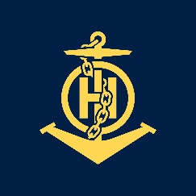
During and After My CHART project
IHO – NIPPON FOUNDATION
ALUMNI SEMINAR
Kazufumi MATSUMOTO (Japan)

Slide 2
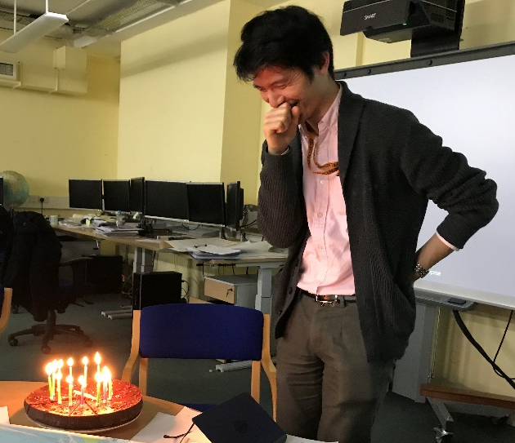
Self introduction
IHO – NIPPON FOUNDATION
ALUMNI SEMINAR
Name | Kazufumi MATSUMOTO (Kazu)
Alumni year | 2018 (last year)
Country | Japan
Organization | JHOD (Japan Hydrographic and Oceanographic Department) in Japan Coast Guard
Position/Job title | Cartography Officer
Current job description | 1. To lead a project to replace the chart production system 2. To produce ENCs and Paper charts (new editions)

Slide 3
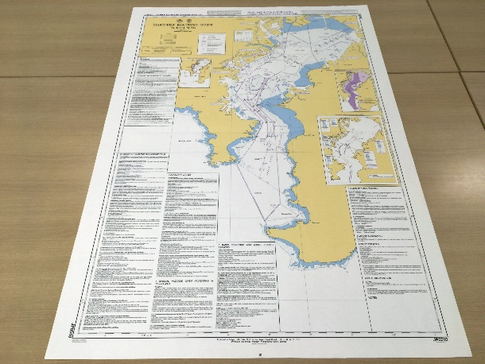
My career path and projects / Achievements
IHO – NIPPON FOUNDATION
ALUMNI SEMINAR
0. Sept. 2018 – Dec. 2018
- CHART project in UKHO
1. Dec. 2018 – Jan. 2019
- produce a new edition of Mariners’ Routeing Guide of Tokyo Bay
2. Jan. 2019 – Mar. 2019
- produce new editions of 3 paper charts and the corresponding ENCs
3. Apr. 2019 -
- lead a project to replace the chart production system

Slide 4
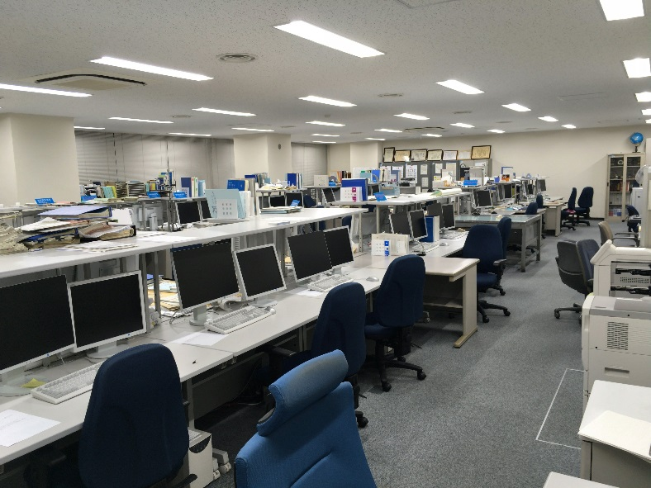
Lessons learned from CHART Course
IHO – NIPPON FOUNDATION
ALUMNI SEMINAR
For replacement project
- production process from source data to products
- way to assess received data
- way to produce Notices to Mariners
- co-operation through internal networking, some Japanese alumni involved (Shuji;2011, Michiko;2012, Rumi;2017)
about 30 staff working there
(but empty in this pic…)

Slide 5
Suggestion for the future
IHO – NIPPON FOUNDATION
ALUMNI SEMINAR
1. ECDIS study
- to provide an opportunity to study ECDIS and relevant standards
2. IHO meeting
- to match IHO meeting schedule to that of training course
- to let students attend it as a class trip in one or half a day
3. Optional visit
- to provide opportunities to visit and work at internal sections in UKHO or governmental organizations all over the world in a short time
- to let each student decide where to visit

Slide 6
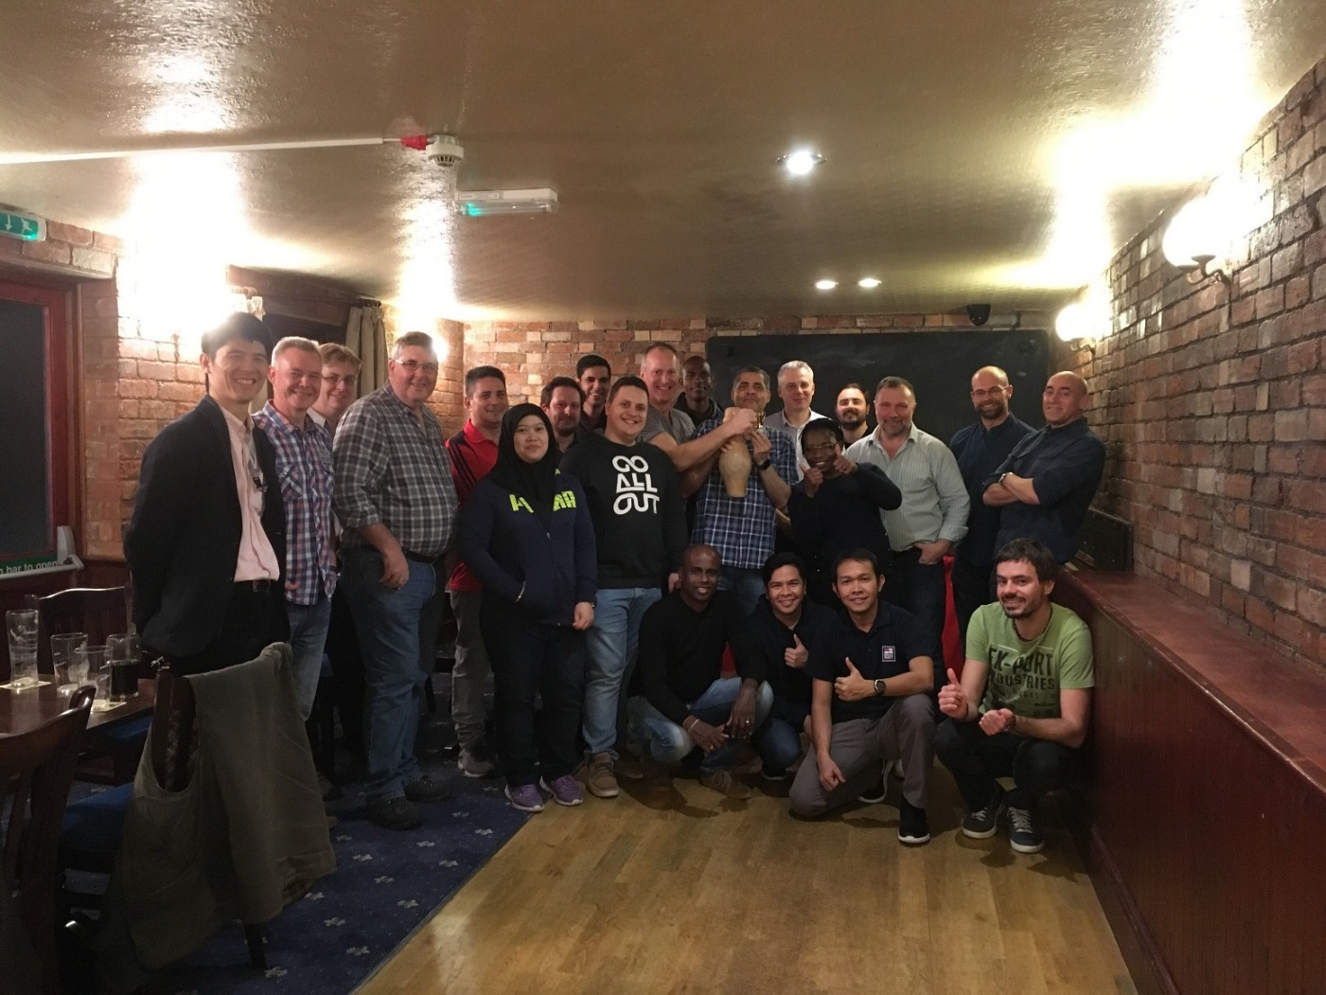
Thank you for your listening.
One of my favorite sports...
I appreciate that UKHO, IHO and NF hold every-year training course.
I hope that I meet you at the various international meetings in the future.

